Slide 1
SBE 4032: Advanced Topics in Medical Informatics (2)
موضوعات متقدمة في المعلوماتية الطبية (2)
Lecture 11: An Introduction to Convolutional Neural Network

Slide 2
Deep Learning Vs. Classical Machine Learning
Deep learning has become the wining player in numerous pattern recognition competitions
Main advantage is that it does so without feature engineering (or hand-crafted features)
Classical (Traditional) ML pipeline
Input Data
Preprocessing & Features Extractor
Traditional Machine Learning
Results or Output
Deep Learning pipeline
Input Data
Deep Learning Algorithm
Results or Output

Slide 3
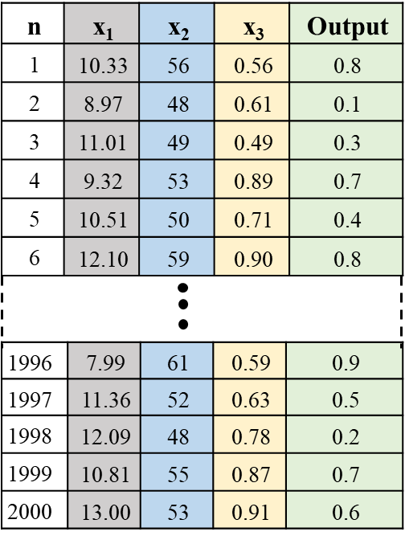
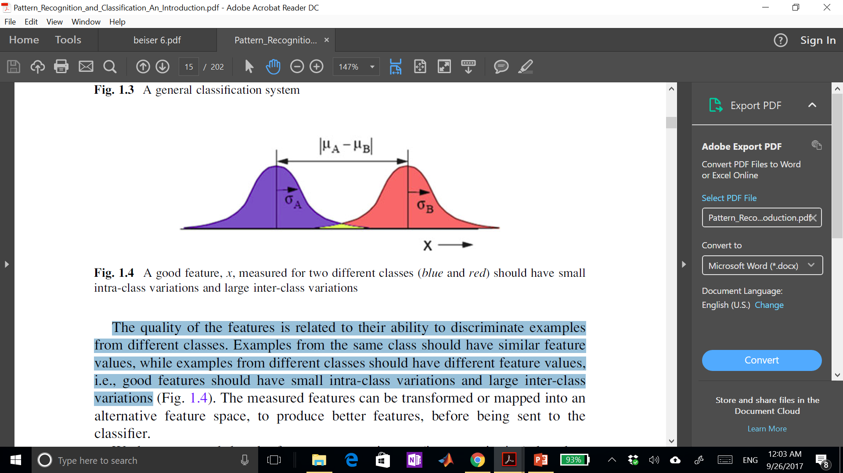
Features Selection for Classical ML
Features are distinctive aspect or characteristic of objects (e.g., tumor shape or volume).
Features’ quality is related to their ability to discriminate subjects from different classes (normal and abnormal).
Subjects from the same class should have common feature values, while examples from different classes should have different feature values
Good (discriminative) features should have small intra-class variations and large inter-class variations
Class A
Class B
In classical ML, features selection is very challenging and must be carefully chosen
Feature x values

Slide 4
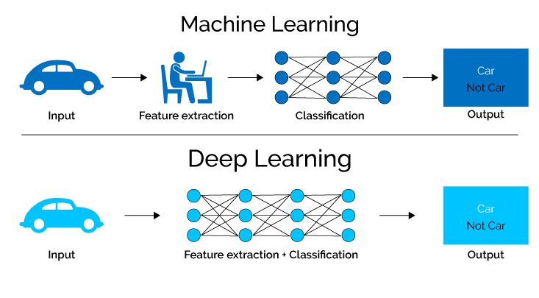
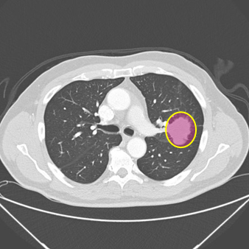
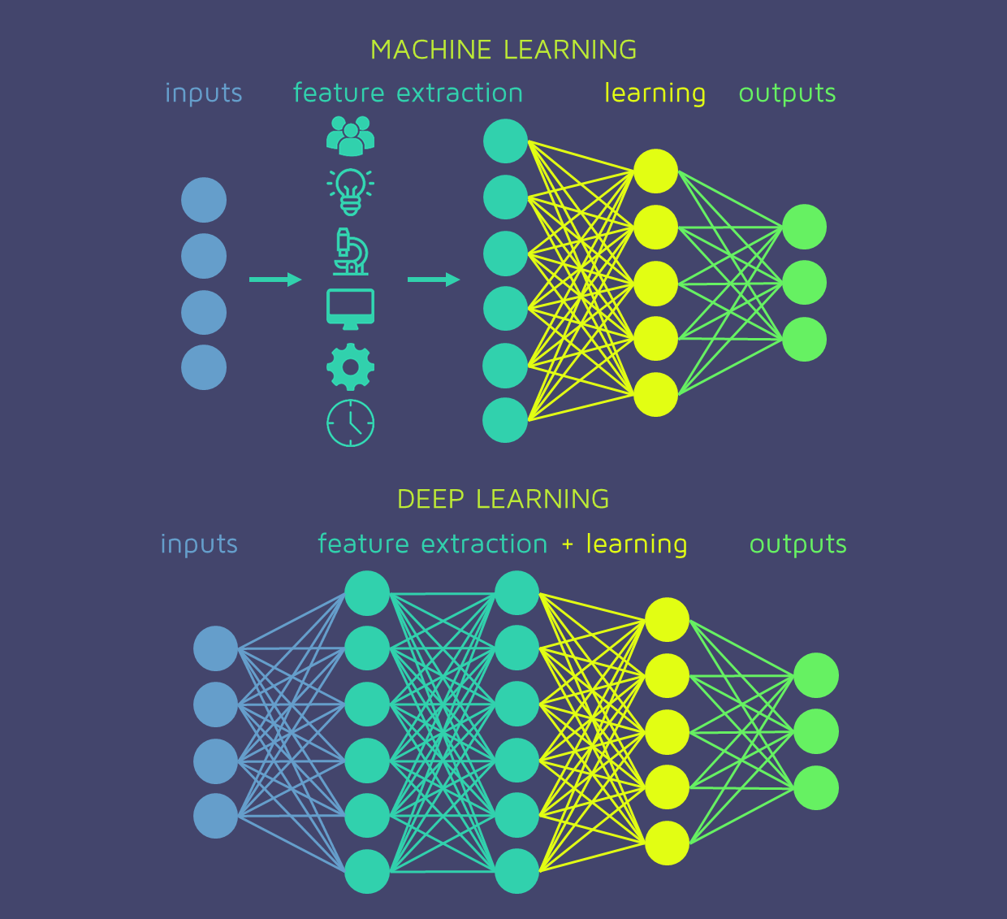
Deep Learning (cont’d)
Classical MedIA
DL-based MedIA
SVM, RF, Decision trees
Benign
Malignant
Benign
Malignant
[1]
[1]
Input
Input
[2]
Input
Input
[2]
SVM, RF, Decision trees
Benign
Benign
Malignant
Malignant
Image source:
[1] https://semiengineering.com/deep-learning-spreads/
[2] https://quantdare.com/what-is-the-difference-between-deep-learning-and-machine-learning/deep_learning/

Slide 5
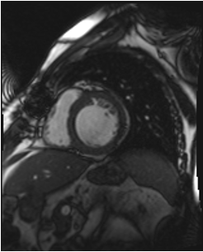
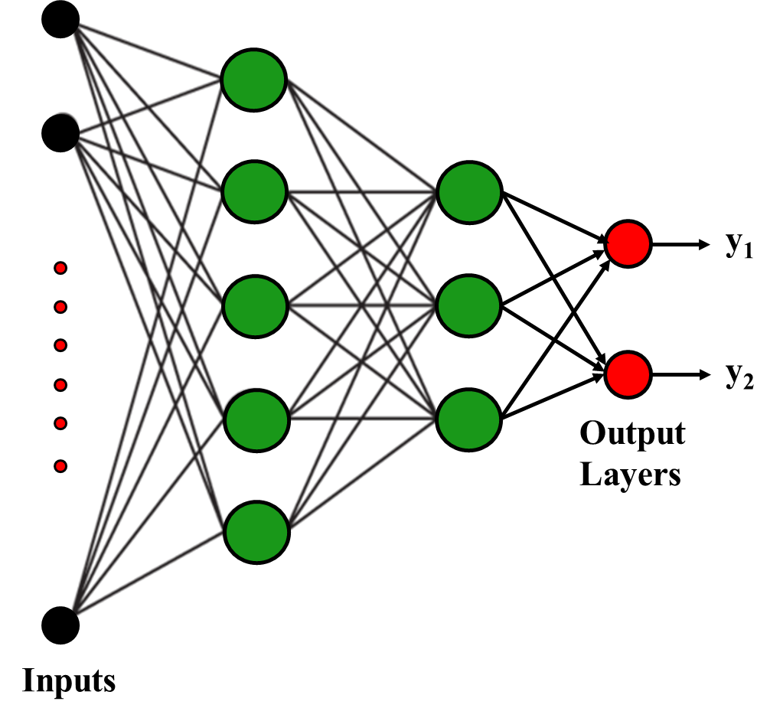
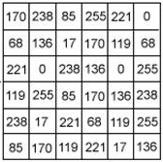
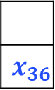
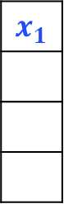
The Need for Convolutional Neural Network (CNN)
Samples or the feature are individual pixel values
$$x_{1}$$
For this part of the image only there are 36 inputs
$$x_{36}$$
Cardiac Cine MR image

Slide 6
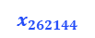
The Need for CNN (cont’d)
512*512 = 262,144-pixel values
$$x_{1}$$
What if we take the whole image as an input
Cardiac Cine MR image
$$x_{262144}$$
Large number of points for just one sample (i.e., an image)
Very dense network with large number of parameters

Slide 7
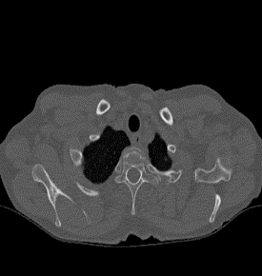
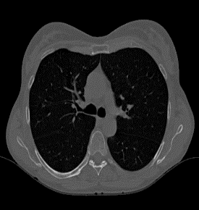
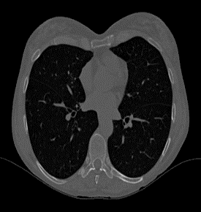
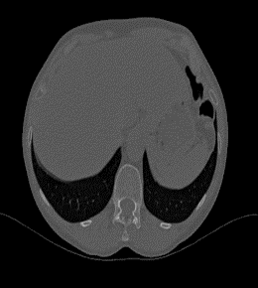
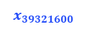
The Need for CNN (cont’d)
This is an impractical large-sized input for an ANN≡ Huge # of weights
More abstracted and meaningful features of the input should be used for practical implementation
$$x_{1}$$
Lung Images
What if we
have 3D images
512*512*150 ~40 M-pixel values
$$x_{39321600}$$
Huge number of points for just one sample (i.e., patient 3D data)
Very dense network with huge number of parameters

Slide 8
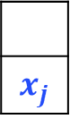
The Need for CNN (cont’d)
Two-fold advantages
It mimics the human visual cortex
It is suitable for processing 2D and 3D images
Small-sized feature(s)
$$x_{1}$$
Lung Images
Input Data Reduction or Meaningful Features Extraction
$$x_{j}$$
512*512*150 ~40 M-pixel values
Notes:
This massive training dataset made it easier than ever for researchers to develop computer vision algorithms and directly lead to similar paradigms for natural language processing and other bedrock AI technologies that we take for granted now. This lead to an age of friendly competition that saw teams around the globe competing to see which could train the most accurate AI.

Slide 9
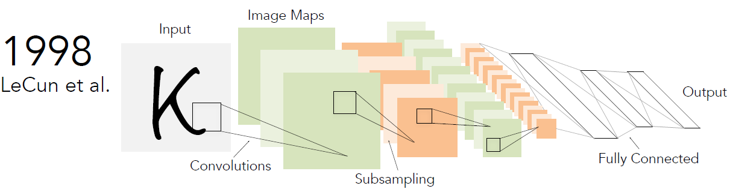
Convolutional Neural Network (CNN)
Convolutional neural networks (CNN or ConvNet) are DL network that possess the availability to learn directly from data and mimic the human visual system, eliminating the need for manual (or the hand-crafted) feature extraction features.
CNNs were around since 90’s and the early version was called LeNet (after LeCun): A network to recognize handwritten digits.

Slide 10
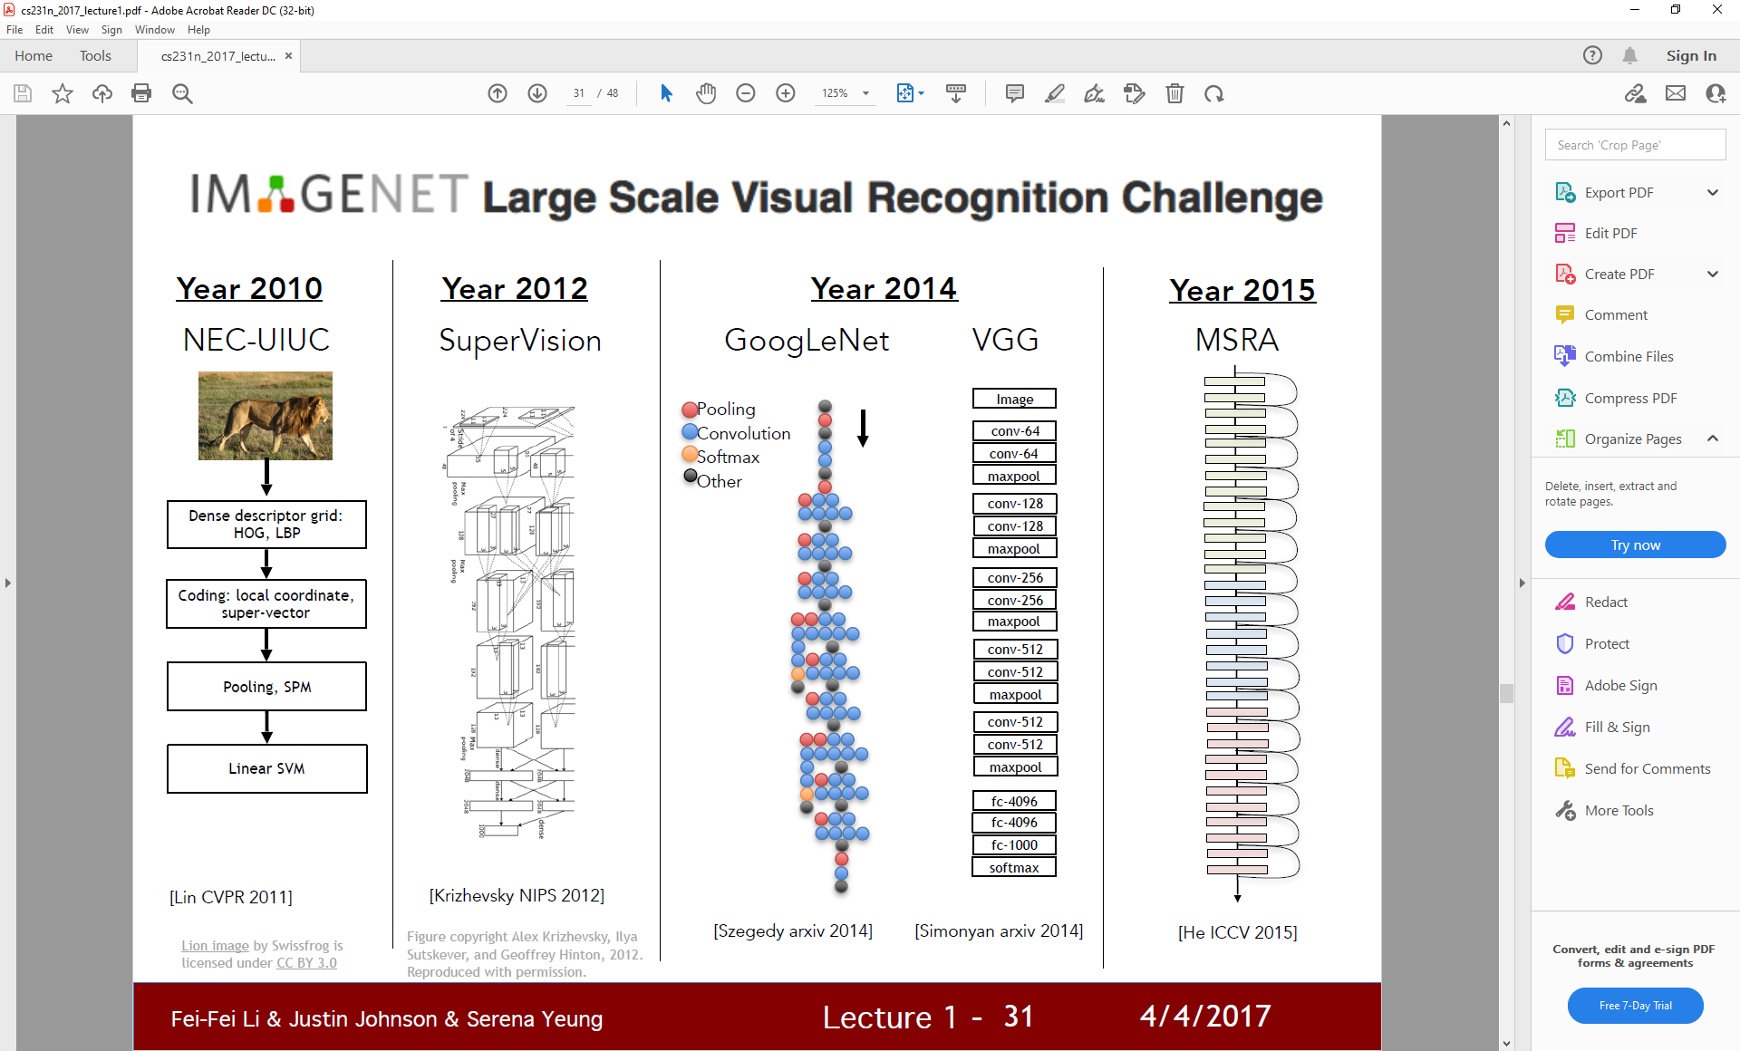
CNNs (cont’d)
AlexNet was the boom of CNN when the authors won ImageNet challenge in 2012 after that become CNN gold standard for image classification.
ImageNet large Scale Visual Recognition Challenge
More models, new architectures, expanded capabilities, new applications, etc.

Slide 11
CNNs (cont’d)
CNNs are NN with some convolutional layers (and some other layers).
In a convolutional layer, the input is convolved with several filters (kernels)
Filters are responsible for detecting hidden patterns in the inputs (e.g., images)
1 | 0 | 0 | 0 | 0 | 1
0 | 1 | 0 | 0 | 1 | 0
0 | 0 | 1 | 1 | 0 | 0
1 | 0 | 0 | 0 | 1 | 0
0 | 1 | 0 | 0 | 1 | 0
0 | 0 | 1 | 0 | 1 | 0
1 | -1 | -1
-1 | 1 | -1
-1 | -1 | 1
Each filter (3 x 3) detects a small pattern (dots, corner, edges, etc.)
Filter 1
-1 | 1 | -1
-1 | 1 | -1
-1 | 1 | -1
Filter 2
Filter weights are the network parameters to be learned.
……
Filter n
6 x 6 image
Modified from: https://www.cs.bgu.ac.il/~dip182/wiki.files/Deep-Learning-2017-Lecture5CNN.pdf
Notes:
dots, edges, or corners. Filters in subsequent layers are combining patterns from previous layers to create larger more complex patterns.

Slide 12
CNNs: Convolution Operation
1 | -1 | -1
-1 | 1 | -1
-1 | -1 | 1
Filter 1
If stride=1
If stride=2
1 | 0 | 0 | 0 | 0 | 1
0 | 1 | 0 | 0 | 1 | 0
0 | 0 | 1 | 1 | 0 | 0
1 | 0 | 0 | 0 | 1 | 0
0 | 1 | 0 | 0 | 1 | 0
0 | 0 | 1 | 0 | 1 | 0
Dot
product
3
-1
-3
-1
3
-3
3
-1
-3
1
0
-3
-3
-3
0
1
3
-2
-2
-1
6 x 6 image
Modified from: https://www.cs.bgu.ac.il/~dip182/wiki.files/Deep-Learning-2017-Lecture5CNN.pdf

Slide 13
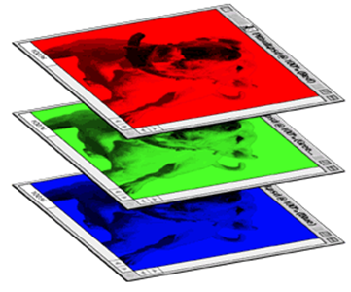
Convolution Operation (cont’d)
1 | -1 | -1
-1 | 1 | -1
-1 | -1 | 1
-1 | 1 | -1
-1 | 1 | -1
-1 | 1 | -1
1 | -1 | -1
-1 | 1 | -1
-1 | -1 | 1
-1 | 1 | -1
-1 | 1 | -1
-1 | 1 | -1
1 | -1 | -1
-1 | 1 | -1
-1 | -1 | 1
-1 | 1 | -1
-1 | 1 | -1
-1 | 1 | -1
Filter 1
Filter 2
Color image
1 | 0 | 0 | 0 | 0 | 1
0 | 1 | 0 | 0 | 1 | 0
0 | 0 | 1 | 1 | 0 | 0
1 | 0 | 0 | 0 | 1 | 0
0 | 1 | 0 | 0 | 1 | 0
0 | 0 | 1 | 0 | 1 | 0
1 | 0 | 0 | 0 | 0 | 1
0 | 1 | 0 | 0 | 1 | 0
0 | 0 | 1 | 1 | 0 | 0
1 | 0 | 0 | 0 | 1 | 0
0 | 1 | 0 | 0 | 1 | 0
0 | 0 | 1 | 0 | 1 | 0
1 | 0 | 0 | 0 | 0 | 1
0 | 1 | 0 | 0 | 1 | 0
0 | 0 | 1 | 1 | 0 | 0
1 | 0 | 0 | 0 | 1 | 0
0 | 1 | 0 | 0 | 1 | 0
0 | 0 | 1 | 0 | 1 | 0
Modified from: https://www.cs.bgu.ac.il/~dip182/wiki.files/Deep-Learning-2017-Lecture5CNN.pdf

Slide 14

A Generic CNN Architecture
CNNs are NN with some convolutional layers (and some other layers).
Flatten
layer
Convolutional layers
and some other layers.
Convolution
Activation
Spatial Pooling
Convolution
Activation
Spatial Pooling
Input
Data
Output Layer (Softmax)
C₁
C₂
C_{i} is class # i
C₃
New images or maps
Fully Connected
(FC) layer
Feature Extraction
Classification
Probabilistic
Distribution

Slide 15
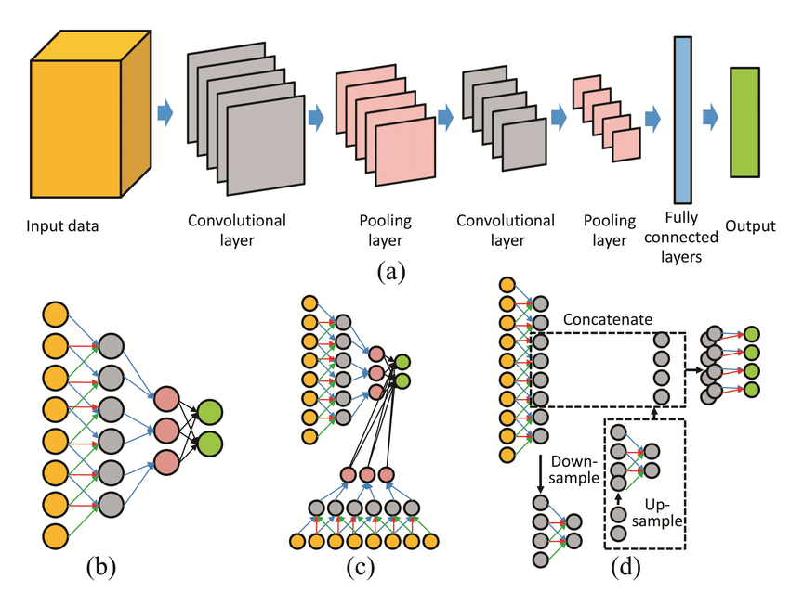
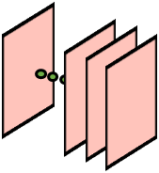
A Generic CNN Architecture (cont’d)
Can be repeated multiple times
Feature maps
Input*filters
Flatten
Input
Data
Output
Layer
Convolutional
Layer+ Activation
Pooling
Layer
Fully
Connected
(FC) Layer
High-level
feature (Global)
Low-level feature (Local)
The output(s) of each operation is known as a feature (or activation) map(s)
Notes:
We can say that filters can detect local features at the shallow layers and start to capture more global (shape) features at the deeper layers!

Slide 16
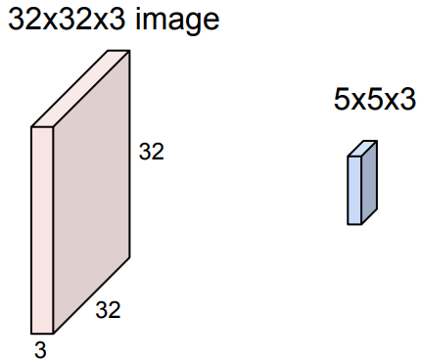
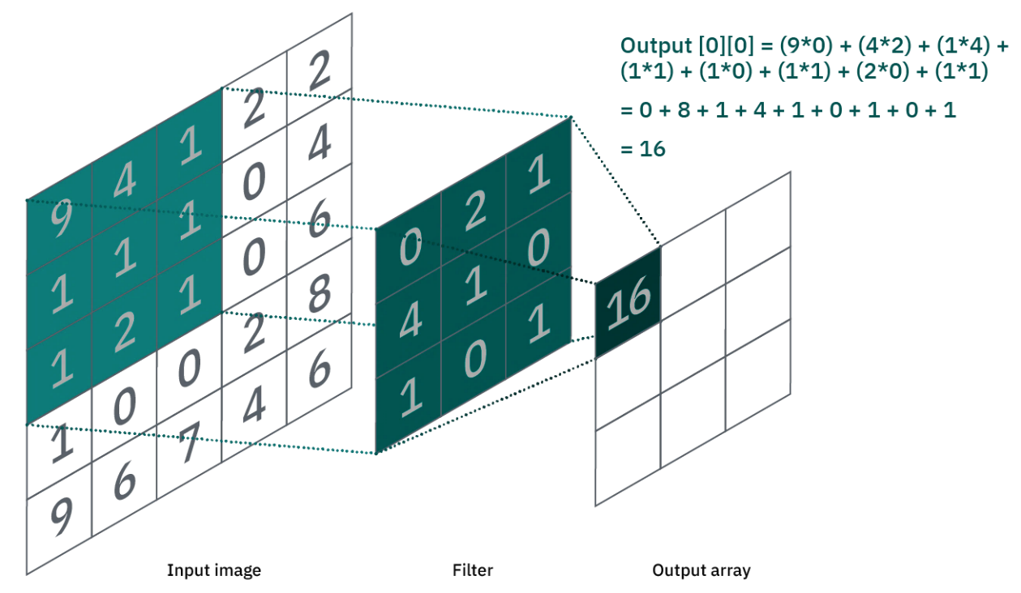
CNN: Convolution Layer
In the convolution layer, a given input image is convolved with a filter (or a kernel)
The filter depth and image depth are the same
The output is the sum of dot product of the filter weights and the image values
32x32x3 image
32x32x3 image
5x5x3 kernel
5x5x3 kernel

Slide 17
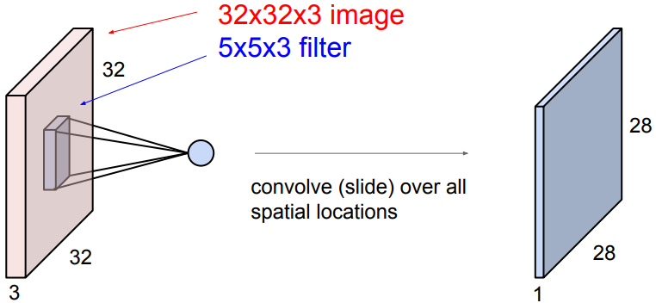
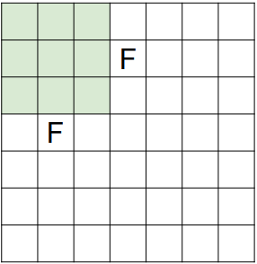
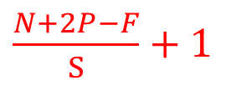

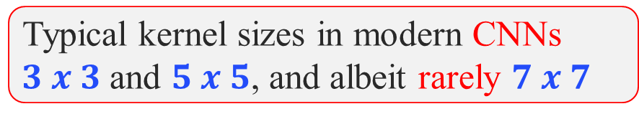

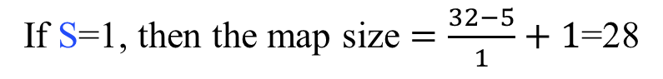

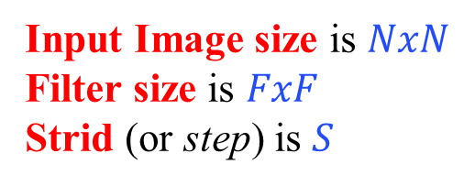
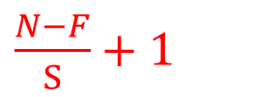



Convolution Layer (cont’d)
What will be the size of the activation map?
Input Image size is $NxN$
Filter size is $FxF$
Strid (or step) is $S$
Activation map
$$P$$
$$N+2P$$
$$P$$
$$N$$
$$N$$
$$N+2P$$
Output Image size
If S=1, then the map size $=\frac{32−5}{1}+1$=28
$\frac{N−F}{S}+1$
Without padding
Typical kernel sizes in modern CNNs
$3 x 3$and $5 x 5$, and albeit rarely $7 x 7$
With padding
$\frac{N+2P−F}{S}+1$

Slide 18
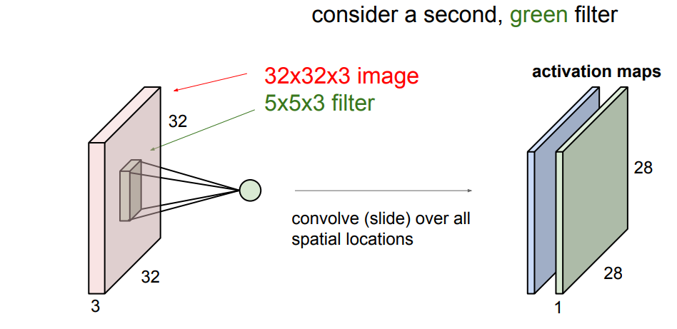
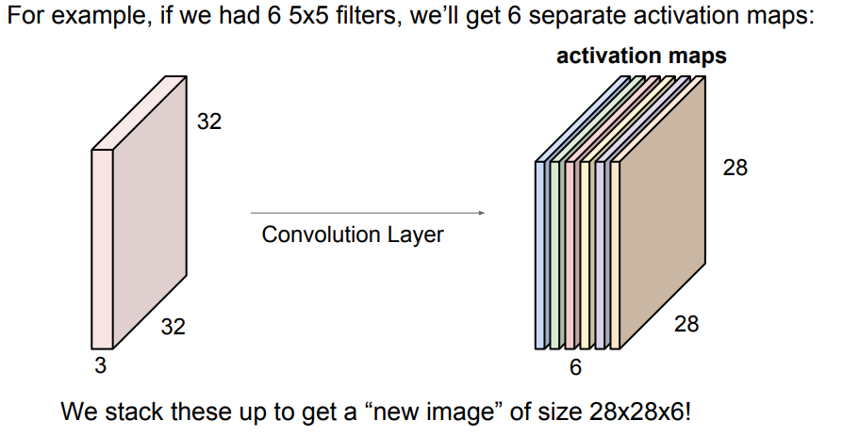
Convolution Layer (cont’d)
Convolve the same image with another filter, a green one
Suppose we have 6 kernels, we will get 6 separate activation maps
Stacking the results of the six-convolution operation gives a “new image” of size $28x28x6$

Slide 19
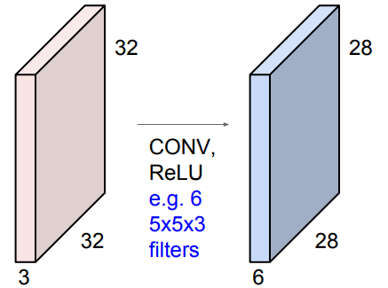
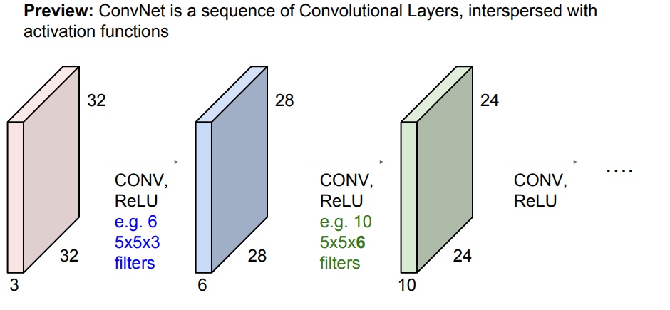
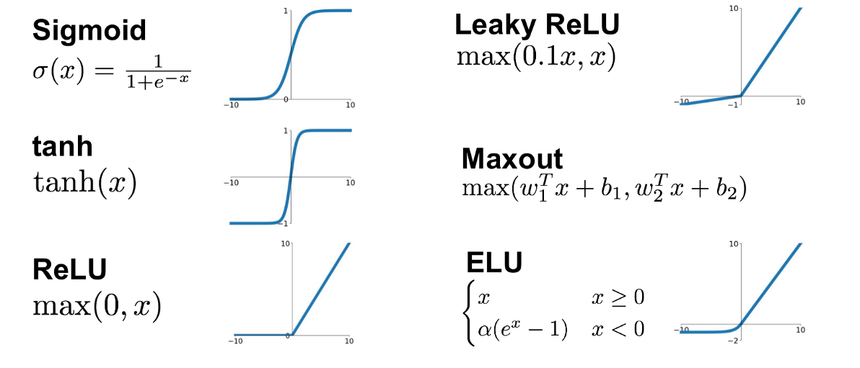
Activation Function
The convolution layers are interspersed by activation function to learn complex information
Please see this link for keras activation functions: https://keras.io/api/layers/activations/

Slide 20
A Generic CNN Architecture
Can be repeated multiple times
Flatten
Input
Data
Output
Layer
Convolutional
Layer+ Activation
Pooling
Layer
Fully
Connected
(FC) Layer

Slide 21
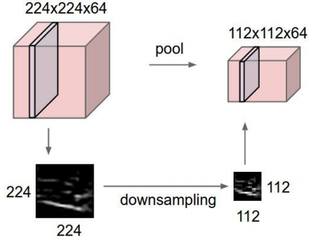

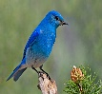
CNN: Pooling Layer
It compresses the input into a lower-dimensional representation, thus makes it more manageable
Like convolution operation, a window with parametrized size and stride is slide over each activation map independently and then select (compute) a single value, i.e., maximum (average)
Thus, as if we subsample the pixels to make image smaller
The bird stays a bird
Fewer parameters to characterize the image
Image source: https://computersciencewiki.org/index.php/Max-pooling_/_Pooling
Notes:
Why pooling (low varanace, lower computional,

Slide 22

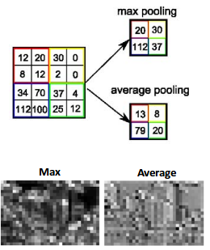

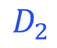
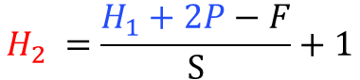
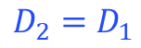
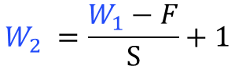
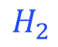
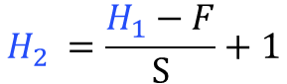
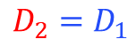
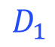
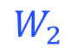
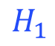
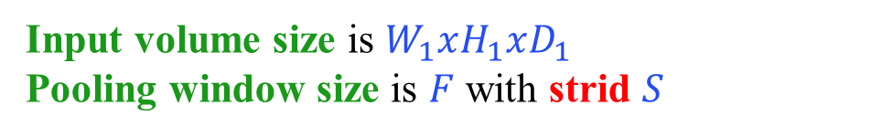

Pooling Layer (cont’d)
What will be the size of the output of the pooling layer?
Input volume size is $W_{1}xH_{1}xD_{1}$
Pooling window size is $F$ with strid $S$
$$H_{2} =\frac{H_{1}−F}{S}+1$$
$$W_{2} =\frac{W_{1}−F}{S}+1$$
$$D_{2}=D_{1}$$
With padding
$$H_{2} =\frac{H_{1}+2P−F}{S}+1$$
$$W_{2} =\frac{W_{1}+2P−F}{S}+1$$
$$D_{2}=D_{1}$$
Image source: https://www.quora.com/What-is-max-pooling-in-convolutional-neural-networks
pooling
This step does NOT introduce any parameters as it ONLY perform fixed computations of the activation map values
$$H_{1}$$
$$H_{2}$$
$$W_{2}$$
$$W_{1}$$
$$D_{2}$$
$$D_{1}$$

Slide 23
A Generic CNN Architecture
Can be repeated multiple times
Flatten
Input
Data
Output
Layer
Convolutional
Layer+ Activation
Pooling
Layer
Fully
Connected
(FC) Layer

Slide 24



CNN: Fully Connected Layer
Neurons in the FC layer have full connections to all activations in the previous layer, as in regular NNs.
Their activations can hence be computed with a matrix multiplication followed by a bias offset.
4
-2
3
4 | -2 | 3
0 | 1 | 2
-1 | 6 | 5
0
8 | 1 | 0
-3 | 6 | 5
0 | 2 | -5
$$y1$$
1
$$y2$$
Flattened
$$y3$$
Assume two
activation maps
0
2
-5
18 Input

Slide 25
A Generic CNN Architecture
Can be repeated multiple times
Flatten
Input
Data
Output
Layer
Convolutional
Layer+ Activation
Pooling
Layer
Fully
Connected
(FC) Layer

Slide 26







CNN: Output Layer
Neurons in the FC layer output real values ($yk$).
For multilabel classification, we need to determine the winner label (class) in a probabilistic manner
The Softmax converts the scores ($yk$) to a normalized probability distribution
Flatten
compute the
class scores
Convolution
Activation
Spatial Pooling
Convolution
Activation
Spatial Pooling
$$y1$$
Softmax Activation Function
C₁
$$y2$$
C₂
$$y3$$
C₃
C_{i} is class # i
Probability of each label, $P(C_{i}) =\frac{e^{y_{i}}}{\sum_{j=1}^{K}{e^{y_{j}}}}$
Sum of all Probability =1 → $\sum_{i=1}^{K}{P(C_{i})}=1$

Slide 27





CNN in Keras
1 | -1 | -1
-1 | 1 | -1
-1 | -1 | 1
Pooling window size is $2x2$ and strid is 2
-1 | 1 | -1
-1 | 1 | -1
-1 | 1 | -1
……
There are 25 3x3 filters.
3
-1
3
Input_shape = ( 28 , 28 , 1)
-3
1
28 x 28 pixels
1: greyscale, 3: RGB
Modified from: https://www.cs.bgu.ac.il/~dip182/wiki.files/Deep-Learning-2017-Lecture5CNN.pdf

Slide 28


CNN in Keras (cont’d)
Input data
1 x 28 x 28
Convolution
Output
How many parameters for each filter?
9
25 x 26 x 26
Max Pooling
Fully connected feedforward network
25 x 13 x 13
Convolution
How many parameters
for each filter?
50 x 11 x 11
225=25x9
Max Pooling
50 x 5 x 5
1250
Flattened

Slide 29


Popular CNN Architectures
LeNet, 1998
Output
Image Source: https://medium.com/analytics-vidhya/cnns-architectures-lenet-alexnet-vgg-googlenet-resnet-and-more-666091488df5
5 layers
Only 5x5 convolutions
Average-Pooling
10 possible classes (0-to-9)
~60k parameters
It was applied by several banks to recognize hand-written numbers on checks (cheques) digitized in 32x32 pixel greyscale input images.
Image Source: http://d2l.ai/chapter_convolutional-modern/alexnet.html

Slide 30

Popular CNN Architectures
LeNet, 1998
Output
Image Source: https://medium.com/analytics-vidhya/cnns-architectures-lenet-alexnet-vgg-googlenet-resnet-and-more-666091488df5
Image Source: http://d2l.ai/chapter_convolutional-modern/alexnet.html
Table Source: https://www.kaggle.com/code/blurredmachine/lenet-architecture-a-complete-guide
Notes:
Layers are those with learnable parameters

Slide 31


Popular CNN Architectures (cont’d)
LeNet, 1998
AlexNet, 2012
Output
Image Source: https://www.pinterest.com/pin/567805465522531905/
Larger input image size
8 layers with different Conv filter sizes and strides (some with padding)
Max-Pooling
1000 possible classes (ImageNet dataset)
~61M parameters
Image Source: http://d2l.ai/chapter_convolutional-modern/alexnet.html

Slide 32


Popular CNN Architectures (cont’d)
LeNet, 1998
AlexNet, 2012
VGGNet, 2014
16 layers (then another version with 19 layers)
Only 3x3 convolutions (strid = 1), Max Pooling (strid =2)
138 M (or 144 M) parameters
Image Source: https://kjhov195.github.io/2020-02-11-CNN_architecture_3/

Slide 33

Popular CNN Architectures (cont’d)
LeNet, 1998
AlexNet, 2012
VGGNet, 2014
ResNet, 2015
Image Source: https://jason-adam.github.io/resnet50/
Versions: 18, 34, 50, 101, and 152 layers
Only 1x1 and 3x3 Conv in deep layers
Introduction of residual blocks with skip connection
Solve vanishing gradient problem
Speeding up training considerably
Introduce global average pooling
11 to 60M parameters

Slide 34

Popular CNN Architectures: Summary
Recognition error rate
based on annual ImageNet Large Scale Visual Recognition Challenge (ILSVRC) contest
(Zeiler and Fergus Network)
(Squeeze-and-Excitation Network)
Image Source: https://semiengineering.com/new-vision-technologies-for-real-world-applications/

Slide 35

CNN Design: Loss Function
During learning, an optimization strategy is used to minimize error (loss or cost) function of the network.
Mean Squared Error (MSE)
Mean Squared Logarithmic Error (MSLE)
Mean Absolute Error (MAE)
Binary Cross Entropy (BCE)
Hinge
Squared Hinge
Categorical Cross Entropy (CCE)
Sparse CCE (SCCE)
Kullback Leibler (KL)
Regression
Problems
Binary Classification
Problems
Estimate loss
Update weights
New input
→ output
Multiclass
Classification
Problems
only one class is correct out of all possible classes

Slide 36
Thank You & Questions

